Slide 1
Predicting NBA Players’ Points Per Game

Slide 2
Problem Statement
What NBA player statistics contribute the most towards determining what a player’s points per game will be in the following season?
Points per game is a very important statistic representing how much a player contributes to his team’s score & chances of winning

Slide 3
Uses of Analysis
NBA teams & executives can use insights to make decisions about which players to sign & invest in
Will be able to see whether certain players are rising or declining offensively
Players can see which aspects of their game they need to improve in order to increase their points per game average
Increasing average will usually result in higher salaries for players

Slide 4
Datasets
Training Data: https://www.kaggle.com/drgilermo/nba-players-stats?select=Seasons_Stats.csv
Various player statistics from every NBA season between 1950-2017
Final training set had 8,163 rows of data with 24 variables each
Testing Data: https://www.basketball-reference.com/
Statistics from 2017-2020 seasons were self extracted
Final testing set had 918 rows of data with the same 24 variables each

Slide 5
Variables
Age: Age of player at the start of the season
Games: # of games a player played in that season
Games Started: # of games a player started in that season
Usage %: Estimate of the percentage of a team’s plays used by a player
Minutes Per Game: Avg # of minutes per game a player played
FG Per Game: Avg # of field goals a player made per game
FGA Per Game: Avg # of field goals a player attempted per game
3P Per Game: Avg # of three pointers a player made per game
3PA Per Game: Avg # of three pointers a player attempted per game

Slide 6
Variables
2P Per Game: Avg # of two pointers a player made per game
2PA Per Game: Avg # of two pointers a player attempted per game
FT Per Game: Avg # of free throws a player made per game
FTA Per Game: Avg # of free throws a player attempted per game
ORB Per Game: Avg # of offensive rebounds a player had per game
DRB Per Game: Avg # of defensive rebounds a player had per game
AST Per Game: Avg # of assists a player had per game
STL Per Game: Avg # of steals a player had per game
BLK Per Game: Avg # of blocks a player had per game

Slide 7
Variables
TOV Per Game: Avg # of turnovers a player had per game
PF Per Game: Avg # of personal fouls a player had per game
Offensive Box Plus/Minus:
Estimate of the offensive points per 100 possessions a player contributed above a league-average player
Defensive Box Plus/Minus:
Estimate of the defensive points per 100 possessions a player contributed above a league-average player
Points Per Game: Avg # of points a player had per game
Points Per Game Next Season: Avg # of points a player had per game next season

Slide 8
Data Wrangling
Condensed dataset to include only seasons starting from 1985
Converted statistics recorded as totals over entire season to per game averages
Created variable to hold following season’s points per game averages
Rows with missing PTS_Per_Game_Next_Season values were removed
This occurred with a player’s last season or last season overall within dataset
Rows relating to players who did not play in at least 40 games in a season or on average 15 minutes per game were also removed
Non-statistical variables such as team & position were dropped
Advanced measures calculated from values of other simpler measures already included within dataset also dropped

Slide 9
Initial Findings & EDA
# of rows in training set ranges from 193 in 1999 to 330 in 2015
PTS_Per_Game_Next_Season values range from 9.83 in 1998 to 12.22 in 19.89
Minimal up/down variation between 1985 & 2017
Shows that specific/consecutive years & seasons do not affect points
Correlation matrix & scatterplots used to see strength & direction of the correlation each variable has with PTS_Per_Game_Next_Season
Summary statistics & histograms to see distributions & frequencies of variables can be viewed in code

Slide 10
Correlations
Negligible Negative Correlation (-0.39-0):
Age (-0.19)
DBPM (-0.02)
Negligible Positive Correlation (0-0.39):
G (0.18)
3P_Per_Game (0.25)
3PA_Per_Game (0.26)
ORB_Per_Game (0.20)
DRB_Per_Game (0.38)
AST_Per_Game (0.39)
BLK_Per_Game (0.15)
PF_Per_Game (0.22)

Slide 11
Correlations
Slight Positive Correlation (0.40-0.69):
GS (0.48)
OBPM (0.63)
Minutes_Per_Game (0.69)
STL_Per_Game (0.46)
TOV_Per_Game (0.66)
Strong Positive Correlation (0.70-1):
USG% (0.70)
FG_Per_Game (0.82)
FGA_Per_Game (0.81)
2P_Per_Game (0.76)
2PA_Per_Game (0.75)
FT_Per_Game (0.75)
FTA_Per_Game (0.74)
PTS_Per_Game (0.84)

Slide 12
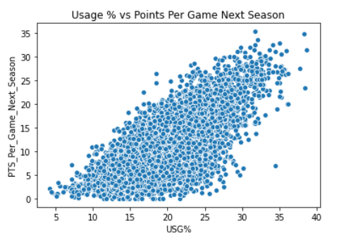
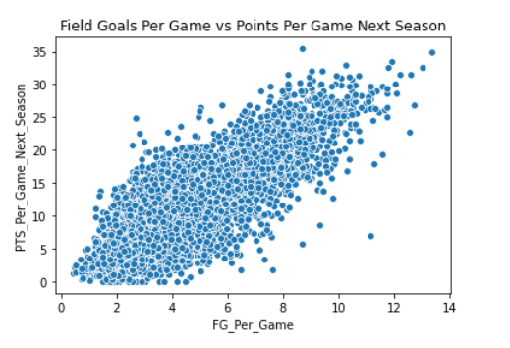
Scatterplots

Slide 13
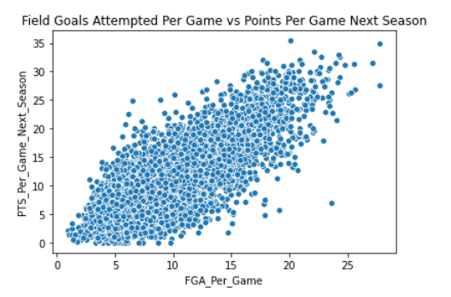
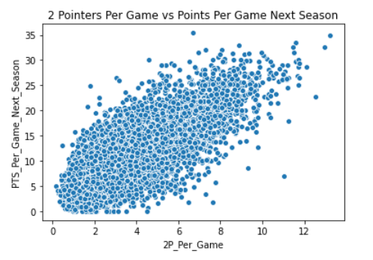
Scatterplots

Slide 14
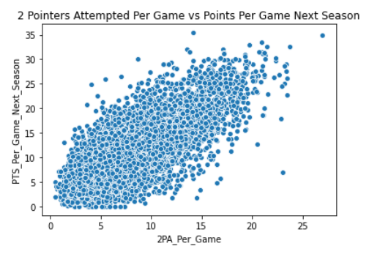
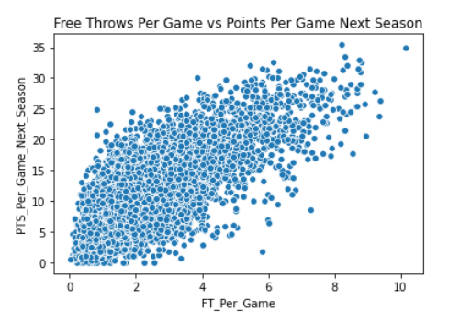
Scatterplots

Slide 15
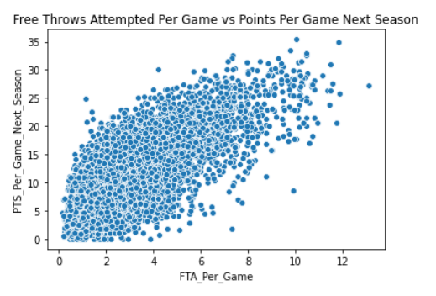
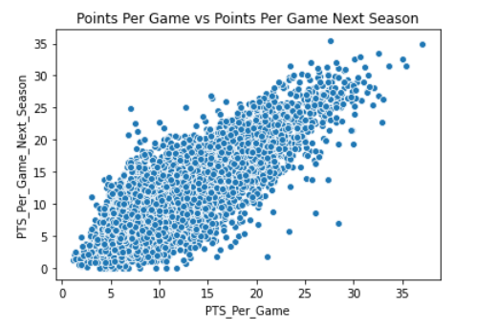
Scatterplots

Slide 16
Machine Learning
Model Used:
Linear Regression
Lasso
Ridge
Random Forest
Gradient Boosting
Support Vector Regression
K-Nearest-Neighbors

Slide 17
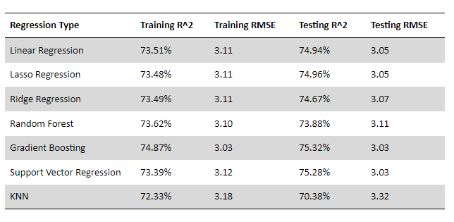
Model Summary

Slide 18
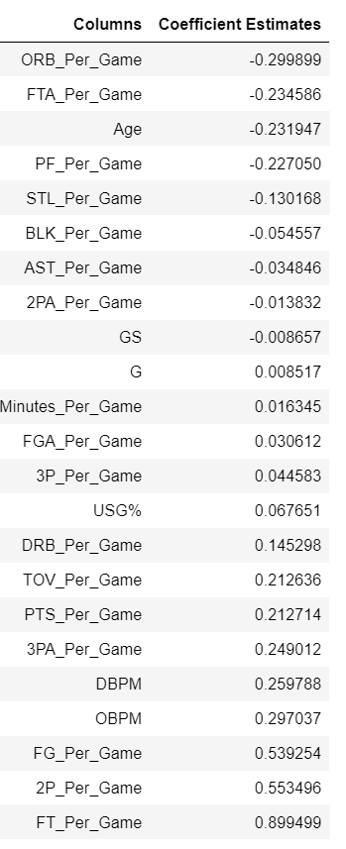
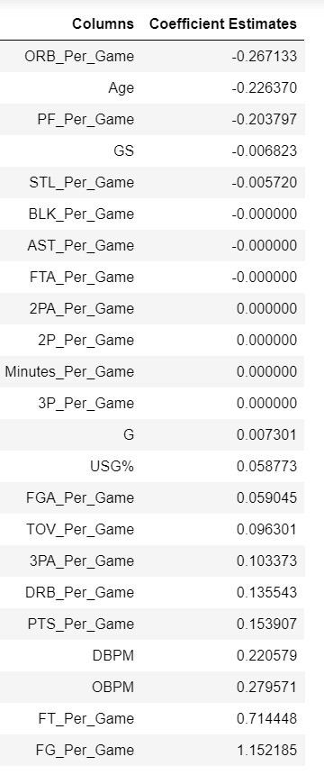
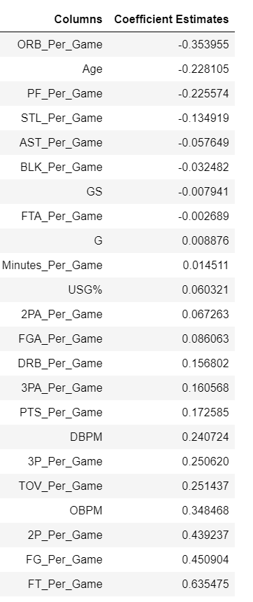
Regression Coefficients
Standard Linear
Lasso
Ridge

Slide 19
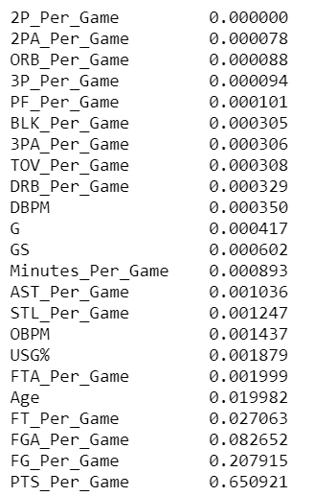
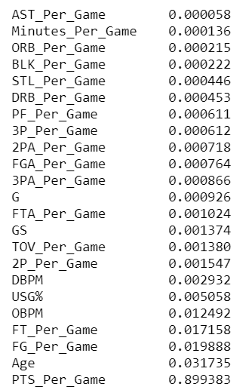
Feature Importances
Random Forest
Gradient Boosting

Slide 20
Conclusions
Testing best performing model on only most recent NBA season resulted in an R^2 score of 77.45% & an RMSE of 3.01 points
Previous season statistics explain a high % of the variation in the points per game average a player will have in the following season
Models can be used to predict points per game averages accurately

